Slide 1
BME680 Gas Sensor
By Sachin V. and Anish K.

Slide 2
What and Why?
The BME680 Gas sensor serves a great purpose in detecting major changed in different levels of kOhms . The levels of kOhms determines if a certain area ( Warehouse , Factory, Manufacturing Plant, etc. ) is contaminated with a certain gas. The way it works is that if there is a immense amount of change in the KOhms level than there normal is, then that means that it there is gas contamination of some kind. For our example, we used propane to test the machine. The next slide will describe the testing methods. Bigger examples of this can be when a factory or industrial plant that involves working gaseous chemicals. They have a hazard zone in which if they enter, they can get injured and it can affect their health. To prevent this, the gas sensor can detect if the gas has been leaked to safegrounds and to keep the people safe from chemical poisoning and such. The use of testing propane specifically is that in places where propane is used in mass amounts this machine would be able to detect if it has been leaked, which will trigger a sense of emergency so that it won’t ignite and burn the whole working ground down. Industrial plants owned by companies produce plastics of different kinds, use it has heating ( HVAC ) used as fuel for running machinery and more. In these places, if there wasn’t something to detect a propane leak, it could cause a catastrophic disaster. This product would sell to major manufacturing plants that involve more than just propane.
Pro Tip : Using this device in a old car can be useful as cars over 20 years have a chances of leaking carbon monoxide and you can’t smell that so it can prevent you from getting CO poisoning

Slide 3
Our plan and timeline
Week 1- explore tinkercad and buy arduino kit
Week 2- explore arduino and build circuit
Week 3- create code and test multiple libraries
Week 4- examine data and find best data fit for presentation
Week 5- record demo make slides
Week 6- revise project and submit

Slide 4
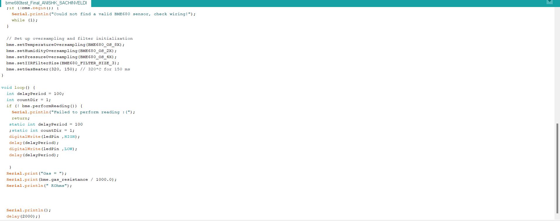
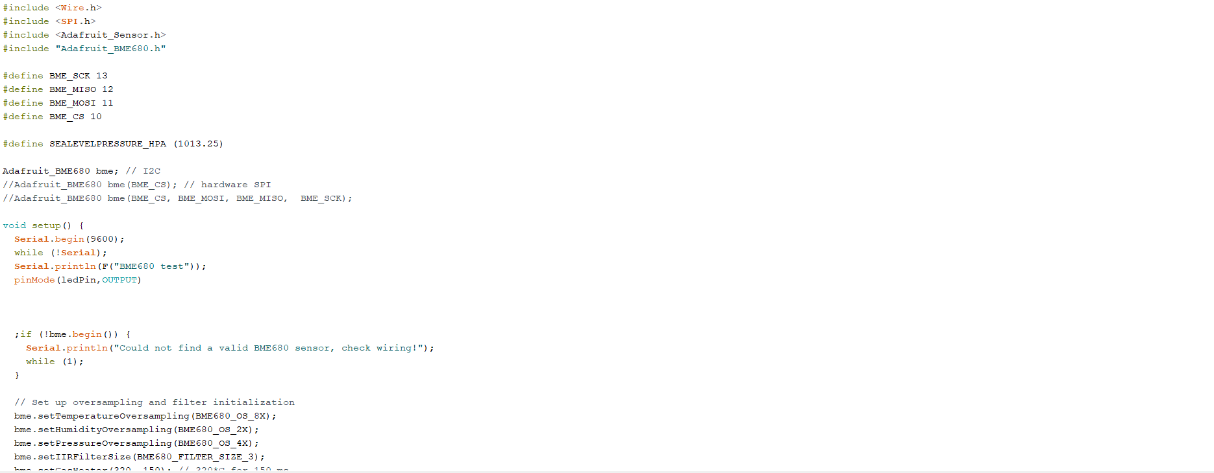
Our circuit design and code

Slide 5

Demo Video

Slide 6
Data and conclusion explanation
Throughout the testing we have done we have found multiple interesting things such as how the BME680 sensor reacts to the propane being released and the sensor sitting still with no propane being released and in the data https://tinyurl.com/BME680-graph1 -click to see graph. the first arrow points to how the data is stabilized then the propane levels rise when we release propane into the room and the second arrow shows how when the propane is stop being released it slowly stabilizes and becomes normal levels when you compare this graph https://tinyurl.com/BME680-graph2 -click to see graph. There is a major difference where in the second graph it is more stable throughout the whole reading and not a rapid amount of change

Slide 7
What we have learnt from this process
Through these 6 weeks we have learnt a lot from uncle and what is arduino and how to use it and also how to use github and what is a repository

